Slide 1
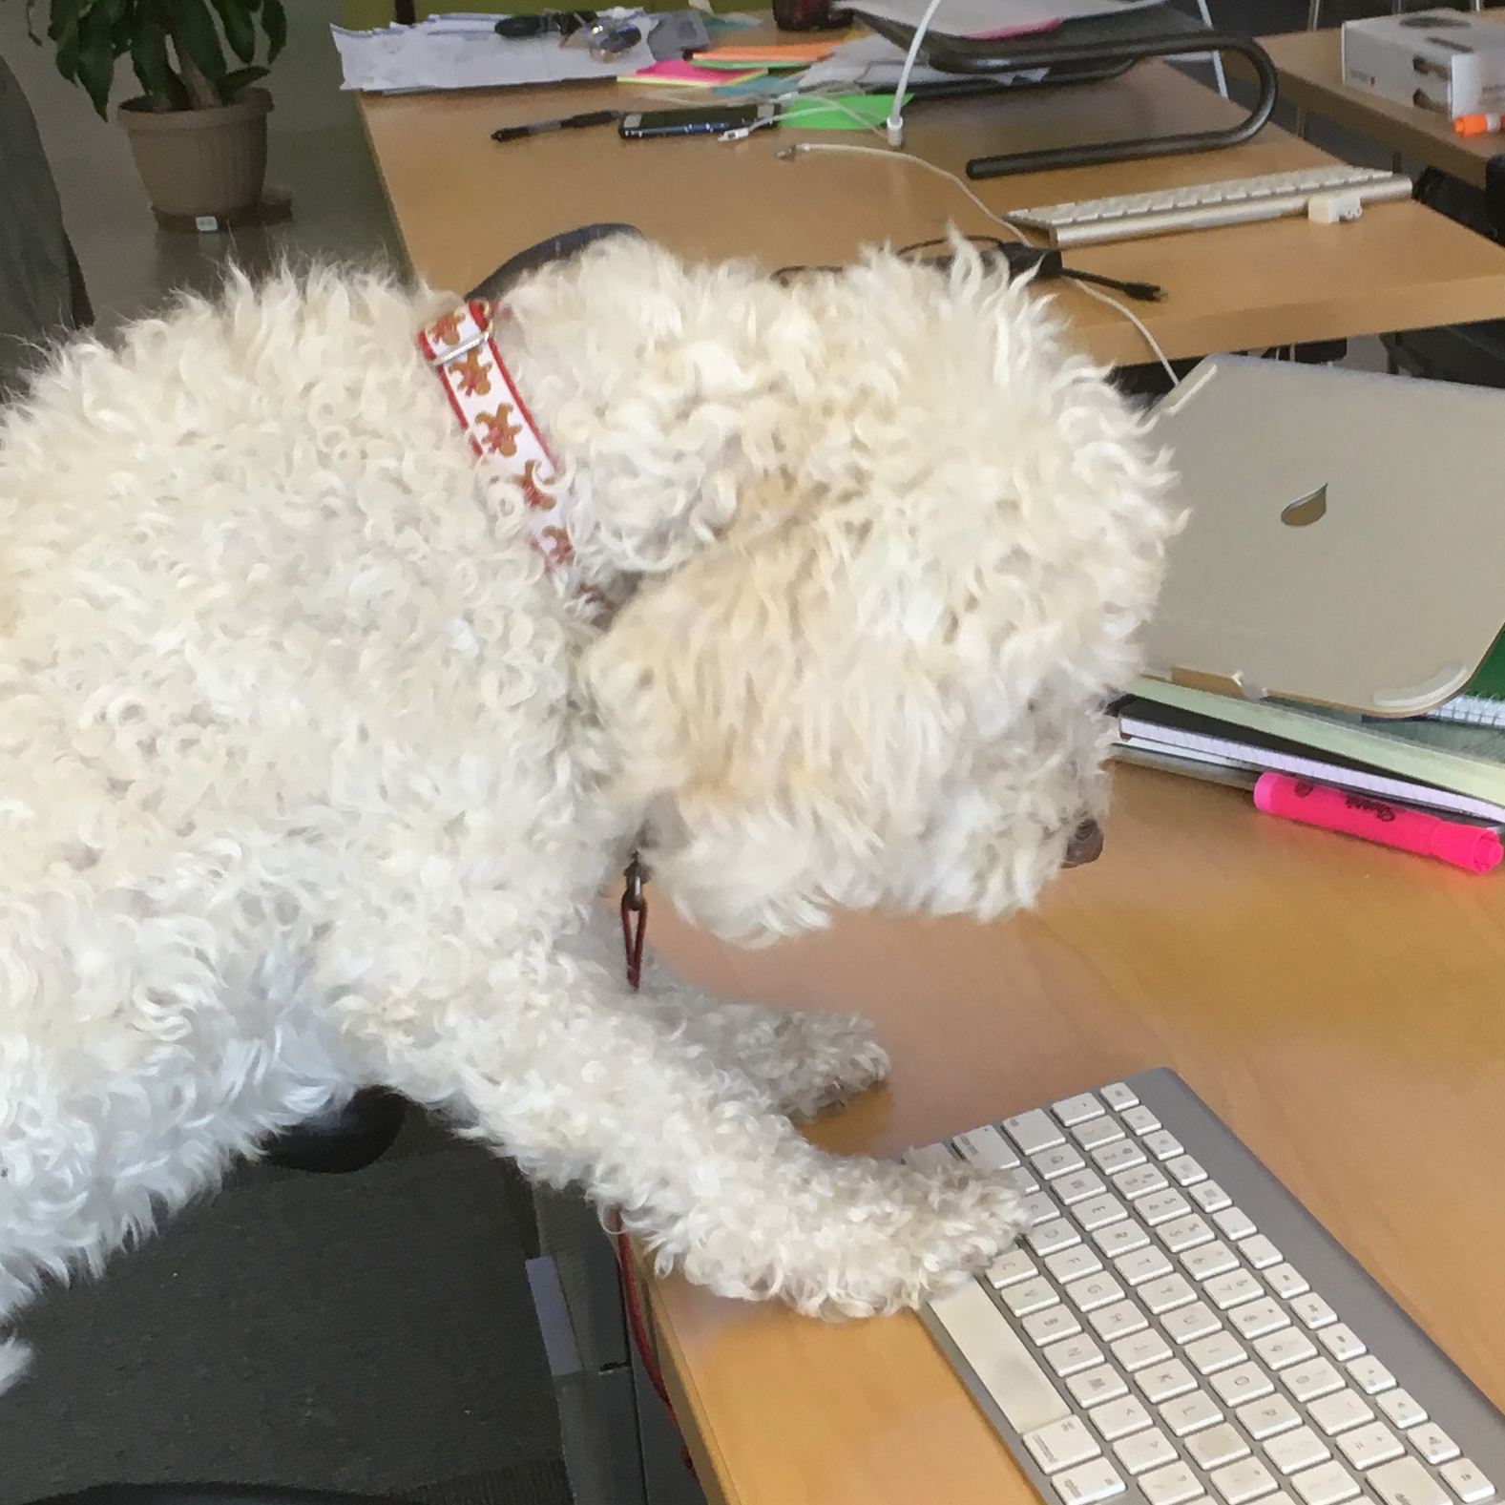
User Manual
Subtitle (optional)
Your name | Your title

Slide 2
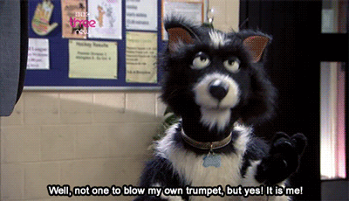
Why? To Play as a Team
1: We have a lot of new folks, several remote team members, so lets get to know each other!! It would be awesome to learn what makes us tick. For eg- What are your individual preferences for communication and collaboration?
Do you have a secret life as a superhero? A zany dare that you would like to share?
2: This is going to be quicker than an intro blog post!! But we do need you to fill this up! We have some examples - but you own this!

Slide 3

How to use this deck template
Step 1: Replace example text prompts in the following slides with your own answers
Step 2: Feel free to use the extra slide formats at the end of this deck to add some personality and/or call out points you think are extra important. Feel free to add your own images.
Step 3: Refer to the main template and graphics kit if you want to further customize. Have fun :) Ask a designer if you need any help!

Slide 4
Conditions I like to work in
I like a quiet working environment. I find it hard to do work that requires my concentration if there is a lot of noise and distractions.
I like having my own desk space
If I have my headphones on, I am in focus mode, so please do not disturb me!
More bullet points if you need them
(You could also put an image on this side to make things more interesting)

Slide 5

The times/hours I like to work
I am trying to start my work day at 9:30 am so that I can have 2 hrs from 7-9 am in the mornings to do things like exercise and meditation etc.
I work best in the afternoons and evenings
I don't mind being contacted at any time but I will likely only respond during week daytimes and evenings
My calendar is open and accessible so everyone can see my availability. I don't mind people booking things in my calendar if I am free

Slide 6

The best ways to communicate with me
Chat is the quickest way to get a response from me. I check some rooms every day (my team and project rooms) and others once a week (like the general design and interest rooms)
I will never answer my phone, but I look at text messages (my # is 555-555-5555)
I check my emails once a day and usually respond within 48 hours at the latest.
I’m always down for an impromptu video call
Just tell it like it is. No need to sugar-coat difficult news for me.

Slide 7
The ways I like to receive feedback
I'd rather have difficult conversations than things be unspoken or inauthentic, so just be straight with me
I like receiving feedback face-to-face
I see all feedback as a learning opportunity so I like any feedback to include specific examples and also suggestions on how I / it could be better/different
Timely feedback is extremely helpful so that the context is fresh in everyone's mind.

Slide 8
Things I need
I love ideas sessions with people, where we can freely think about what is possible without the if's and but's
I need time to reflect and the opportunity to take a couple of brain-breaks during the day. Feel free to challenge me at ping-pong!
Authenticity - I find it really hard to be around bullshit, passive aggressiveness, inconsistency or incongruence
More bullets

Slide 9
How I learn best
Before starting off something, I like to have as much upfront details or context that I can read to get familiar. Although visuals help, I love having things explained to me in detail
I take the time to reflect and absorb what I have learnt before I feel comfortable discussing it in a group. It can be hard for me to react the moment things are first presented to me
More bullets

Slide 10
Things I struggle with
I'm an introvert, so working "in the open" is something I have to work hard at
Too much critiquing and logical reasoning drains my energy
If I don't understand the wider purpose behind why we are doing something, I find it hard to engage with it
More bullets

Slide 11

Things I love
I like hearing what others are working on and connecting up the dots of what we are doing
I love organizing team things - birthday gifts, evenings out etc.
A generative, risk-taking culture that has a flag in the ground about what it stands for
Quarterly team away days
More bullets

Slide 12
Other things to know about me
I use my intuition a lot to make decisions
I am an INFP / INFJ cusp
I don't like or drink coffee
Actions speak way more than words in my book
I'm not very expressive, so people can interpret that as grumpy or they find me hard to read. If I am not happy I will say, so otherwise assume I am fine!
Fairness really matters to me. If I think someone is not being treated fairly, or someone is having an unfair impact on others, I will find it hard not to call out.
I'm known for often being the one to name the white elephant in the room or to ask the question nobody else feel able to ask. This is not a position I enjoy, and it can be very isolating, but because authenticity matters so much to me it is almost like a reflex.

Slide 13
If I were an animated gif/meme/animal/song, I would be...
[add here]

Slide 14
Extra slide layouts

Slide 15
0
number of times I have combined cake and ice cream

Slide 16
The sum of the whole is greater than the sum of the parts.
My favorite saying

Slide 17
It is good to have an end to journey toward, but it is the journey that matters in the end. [you can put a longer quote here]
Ursula le guin

Slide 18
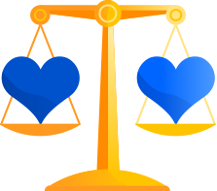
Other things to know about me
I bring my whole self to work (we should chat about what this means to me)

Slide 19
Other things to know about me
Actions speak way more than words in my book

Slide 20
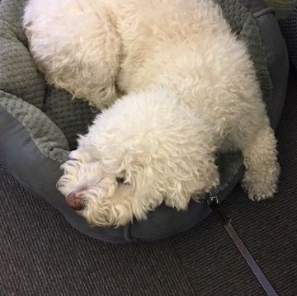
Thank you!
Your name | Your title

